Slide 1


Front End Basics
SoftUni Team
Technical Trainers
Software University
https://softuni.bg

Slide 2
Table of Content
JavaScript
What's JavaScript?
Functions
Objects
Bootstrap
Grid system
Bootstrap components

Slide 3
Have a Question?
sli.do #java-web

Slide 4
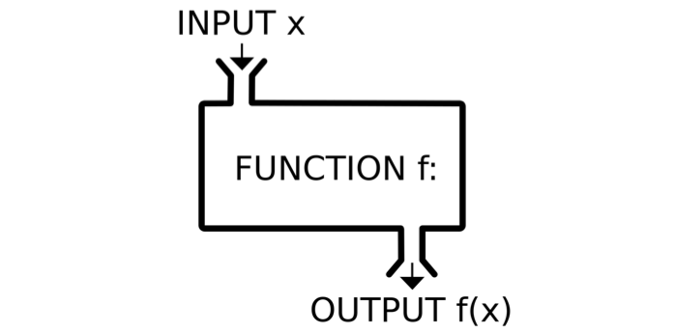
JavaScript

Slide 5
Dynamic Programming Language
JavaScript is a dynamic programming language
Operations otherwise done at compile-time can be done at run-time
It is possible to change the type of a variable or add new properties or methods to an object while the program is running
In static programming languages, such changes are normally not possible

Slide 6
Data Types
Seven data types that are primitives
String - used to represent textual data
Number - a numeric data type
Boolean - a logical data type
Undefined - automatically assigned to variables
Null - represents the intentional absence of any object value
BigInt - represent integers with arbitrary precision
Symbol - unique and immutable primitive value
Data structures

Slide 7
Variable Values
let, const and var are used to declare variables
let - for reassigning a variable
const - once assigned it cannot be modified
var - defines a variable in the lexical scope regardless of block scope
let name = "George";
name = "Maria";
const name = "George";
name = "Maria"; // TypeError
var name = "George";
name = "Maria";

Slide 8
Dynamic Typing
Variables in JavaScript are not directly associated with any particular value type
Any variable can be assigned (and re-assigned) values of all types
let foo = 42; // foo is now a number
foo = 'bar'; // foo is now a string
foo = true; // foo is now a boolean

Slide 9
Comparison Operators
Operator | Notation in JS
EQUAL value EQUAL value and type | == ===
NOT EQUAL value NOT EQUAL value/type | != !==
Greater than | >
Greater than OR EQUAL | >=
LESS than | <
LESS than OR EQUAL | <=

Slide 10

Comparison Operators
console.log(1 == '1'); // true
console.log(1 === '1'); // false
console.log(3 != '3'); // false
console.log(3 !== '3'); // true
console.log(5 < 5.5); // true
console.log(5 <= 4); // false
console.log(2 > 1.5); // true
console.log(2 >= 2); // true
console.log(5 ? 4 : 10); // 4
The "? " is a ternary operator

Slide 11
Functions
Function - named list of instructions (statements and expressions)
Can take parameters and return result
Function names and parameters use camel case
The ' { ' stays on the same line
Invoke the function
function printStars(count) {
console.log("*".repeat(count));
}
printStars(10);

Slide 12
Declaring Functions
Function declaration
Function expression
Arrow functions
function walk() {
console.log("walking");
}
let walk = function (){
console.log("walking");
}
let walk = () => {
console.log("walking");
}

Slide 13
Parameters
You can instantialize parameters with no value
The unused parameters are ignored
function foo(a,b,c){
console.log(a);
console.log(b);
console.log(c); //undefined
}
foo(1,2)
function foo(a,b,c){
console.log(a);
console.log(b);
console.log(c);
}
foo(1,2,3,6,7)

Slide 14
Hoisting
Variable and function declarations are put into memory during the compile phase, but stay exactly where you typed them in your code
Only declarations are hoisted
console.log(num); // Returns undefined
var num;
num = 6;

Slide 15
Hoisting Variables
num = 6;
console.log(num); // returns 6
var num;
num = 6;
console.log(num); // ReferenceError: num is not defined
let num;
console.log(num); // ReferenceError: num is not defined
num = 6;

Slide 16
Hoisting Functions
run(); // running
function run() {
console.log("running");
};
walk(); // ReferenceError: walk is not defined
let walk = function () {
console.log("walking");
};
console.log(walk); //undefined
walk(); // TypeError: walk is not a function
var walk = function () {
console.log("walking");
};

Slide 17
What is an Object?
An object is a collection of fields, and a field is an association between a name (or key) and a value
Objects are a reference data type
You define (and create) a JavaScript object with an object literal:
let person = {
firstName: "John",
lastName: "Doe",
age: 50
};

Slide 18
Variables Holding References
The in-memory value of a reference type is the reference itself (a memory address)
let x = {name: 'John'};
x
let y = x;
name
John
y
y.name = "John";
console.log(x.name); // John

Slide 19
Object Properties
A property of an object can be explained as a variable that is attached to the object
Object properties are basically the same as ordinary JavaScript variables, except for the attachment to objects
Property Name | Property Value
firstName | John
lastName | Doe
age | 50

Slide 20
Object Keys and Values
let course = { name: 'JS Core', hall: 'Open Source' };
let keys = Object.keys(course);
console.log(keys); // [ 'name', 'hall' ]
if (course.hasOwnProperty('name')) {
console.log(course.name); // JS Core
}
let values = Object.values(course);
console.log(values); // [ 'JS Core', 'Open Source' ]
if (values.includes('JS Core')) {
console.log("Found 'JS Core' value");
}

Slide 21
For… in Loop
for … in - iterates a specified variable over all the enumerable properties of an object
let obj = {a: 1, b: 2, c: 3};
for (const key in obj) {
console.log(`obj.${key} = ${obj[key]}`);
}
// Output:
// "obj.a = 1"
// "obj.b = 2"
// "obj.c = 3"

Slide 22
For…of Loop
The for...of statement creates a loop iterating over iterable objects
let obj = {a: 1, b: 2, c: 3};
for (const key of Object.keys(obj)) {
console.log(`obj.${key} = ${obj[key]}`);
}
// "obj.a = 1"
// "obj.b = 2"
// "obj.c = 3"
for (const val of Object.values(obj)) {console.log(val);}
// 1
// 2
// 3

Slide 23

Bootstrap

Slide 24

What is a Responsive Design?
Presentation layers that adjust according to the screen size of the different devices
Desktop layouts
Tablet layouts
Mobile layouts

Slide 25

Bootstrap
World's most popular front-end component library
Open source toolkit for developing with HTML, CSS, and JS
Works with
Responsive grid system
Extensive prebuilt components
Powerful plugins built on jQuery

Slide 26
Include from a BootstrapCDN – JS
Be sure to place jQuery and Popper first, as the Bootstrap code depends on them
JavaScript, Popper.js and jQuery
<script src="https://code.jquery.com/jquery3.3.1.slim.min.js"></script>
<script src="https://cdnjs.cloudflare.com/ajax/libs/popper.js/1.14.7/umd/popper.min.js"></script>
<script src="https://stackpath.bootstrapcdn.com/bootstrap/4.3.1/js/bootstrap.min.js"></script>

Slide 27
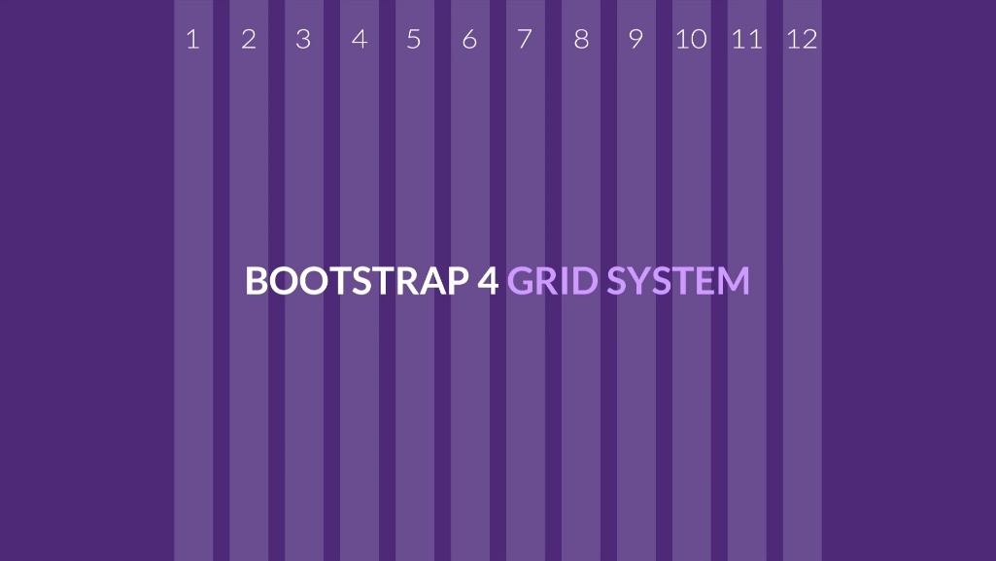
Bootstrap Grid System
Build Layouts with Grid – Twelve Column System

Slide 28

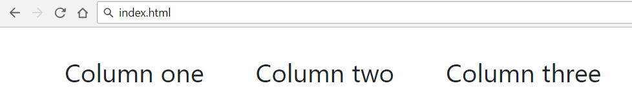
Bootstrap Grid System Demo
index.html
…
<div class="container">
<div class="row">
<div class="col-xs m-3">Column one</div>
<div class="col-xs m-3">Column two</div>
<div class="col-xs m-3">Column three</div>
</div>
</div>
…
Container
Row
Columns

Slide 29
Bootstrap Containers
Rows must be placed in containers
.container has one fixed width for each screen size in bootstrap (xs, sm, md, lg)
.container-fluid expands to fill the available width
Responsive pixel width
width: 100%

Slide 30

Column Classes
Determines how many columns to use on different screen sizes
.col-xs: width less than 768px
.col-sm: width between 768px and 992px
.col-md: width between 992px and 1200px
.col-lg: width over 1200px
index.html
<div class="col-sm-8 col-lg-4">Column one</div>
<div class="col-sm-2 col-lg-4">Column two</div>
<div class="col-sm-2 col-lg-4">Column three</div>

Slide 31
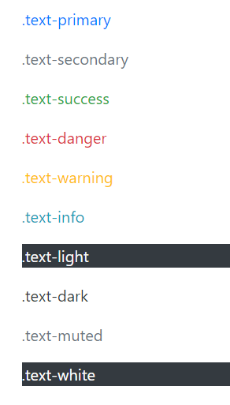
Color
Handful of color utility classes
index.html
<p class="text-primary">.text-primary</p>
<p class="text-secondary">.text-secondary</p>
<p class="text-success">.text-success</p>
<p class="text-danger">.text-danger</p>
<p class="text-warning">.text-warning</p>
<p class="text-info">.text-info</p>
<p class="text-light bg-dark">.text-light</p>
<p class="text-dark">.text-dark</p>
<p class="text-muted">.text-muted</p>
<p class="text-white bg-dark">.text-white</p>

Slide 32
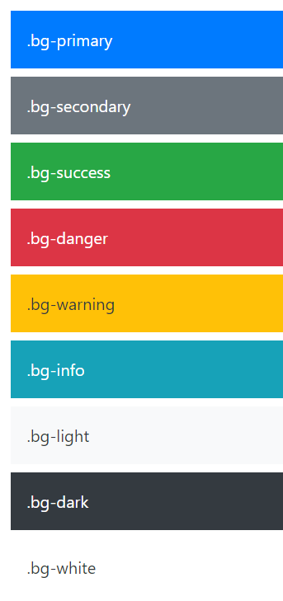
Background Color
Easily set the background of an element to any contextual class
index.html
<div class="bg-primary text-white">.bg-primary</div>
<div class="bg-secondary text-white">.bg-secondary</div>
<div class="bg-success text-white">.bg-success</div>
<div class="bg-danger text-white">.bg-danger</div>
<div class="bg-warning text-dark">.bg-warning</div>
<div class="bg-info text-white">.bg-info</div>
<div class="bg-light text-dark">.bg-light</div>
<div class="bg-dark text-white">.bg-dark</div>
<div class="bg-white text-dark">.bg-white</div>

Slide 33
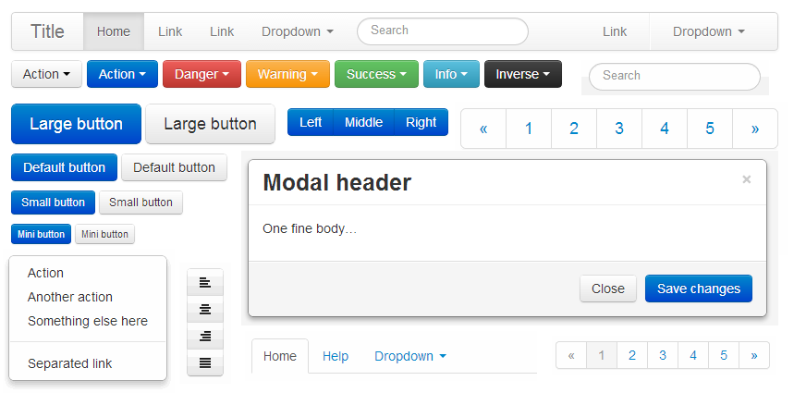
Bootstrap Components

Slide 34
Button Groups
Custom button styles with support for multiple sizes, states, and more
index.html
<button type="button" class="btn btn-primary">Primary</button>
<button type="button" class="btn btn-secondary">Secondary</button>
<button type="button" class="btn btn-success">Success</button>
<button type="button" class="btn btn-danger">Danger</button>
. . .
Documentation: https://getbootstrap.com/docs/4.0/components/buttons/

Slide 35
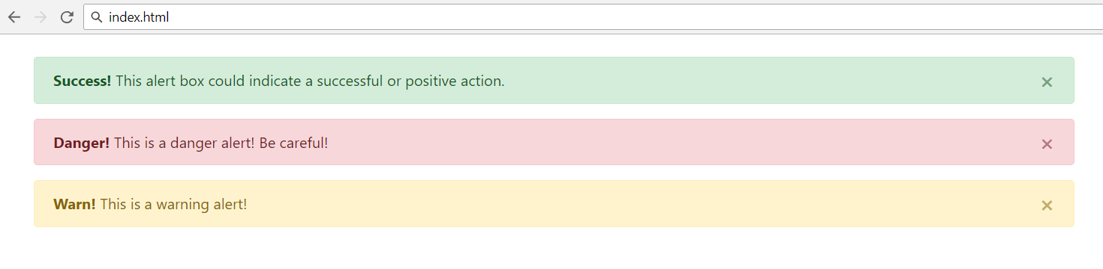
Alerts
Provide contextual feedback messages for typical user actions with the handful of flexible alert messages
<div class="alert alert-success alert-dismissable">
<a class="close" data-dismiss="alert" aria-label="close">×</a>
<strong>Success!</strong> This alert box could indicate a successful or positive action.
</div>
…

Slide 36
Nav and Navbar
Require a wrapping .navbar
Responsive by default
Come with built-in support for a handful of sub-components
.navbar-brand for your company, product, or project name
.navbar-nav for a full-height and lightweight navigation
.nav-item for every item in navigation
See more at: https://getbootstrap.com/docs/4.0/components/navbar/

Slide 37
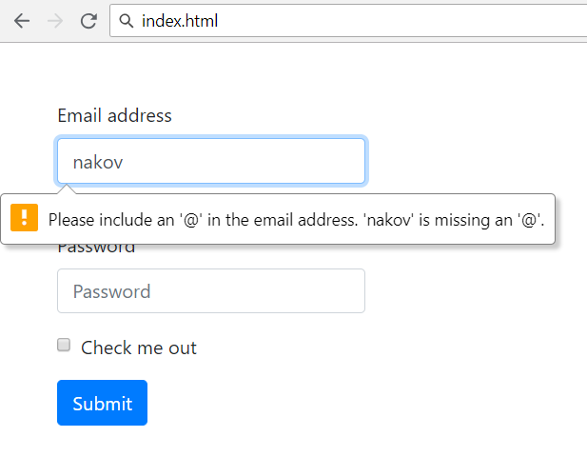

Forms
Form control styles, layout options and custom components for creating a wide variety of forms
Use type attribute on all inputs to take advantage of newer input controls
Email verification
Number selection

Slide 38
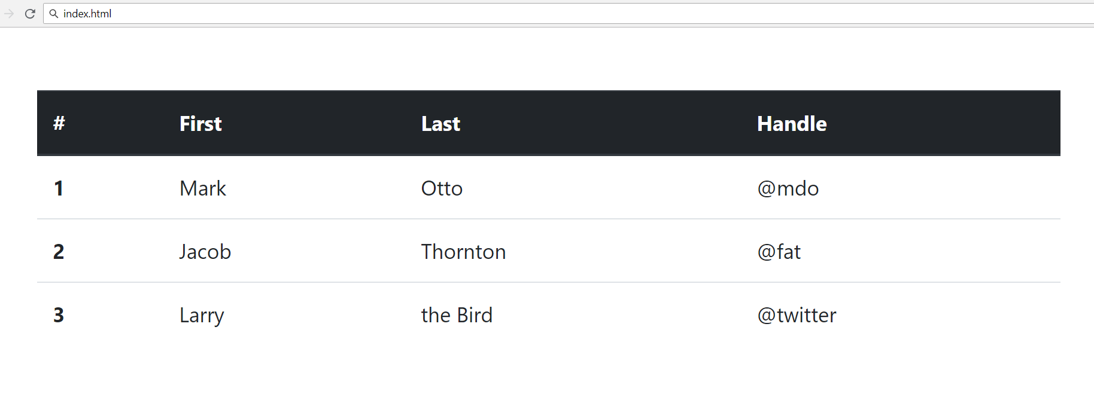
Tables
<table class="table">
<thead class="thead-dark">
<tr> <th scope="col">#</th>
<th scope="col">First</th>
<th scope="col">Last</th>
<th scope="col">Handle</th> </tr>
</thead>
<tbody>
<tr> <th scope="row">1</th>
<td>Mark</td>
<td>Otto</td>
<td>@mdo</td> </tr>
<tr> . . . </tr>
<tr> . . . </tr>
</tbody>
</table>

Slide 39
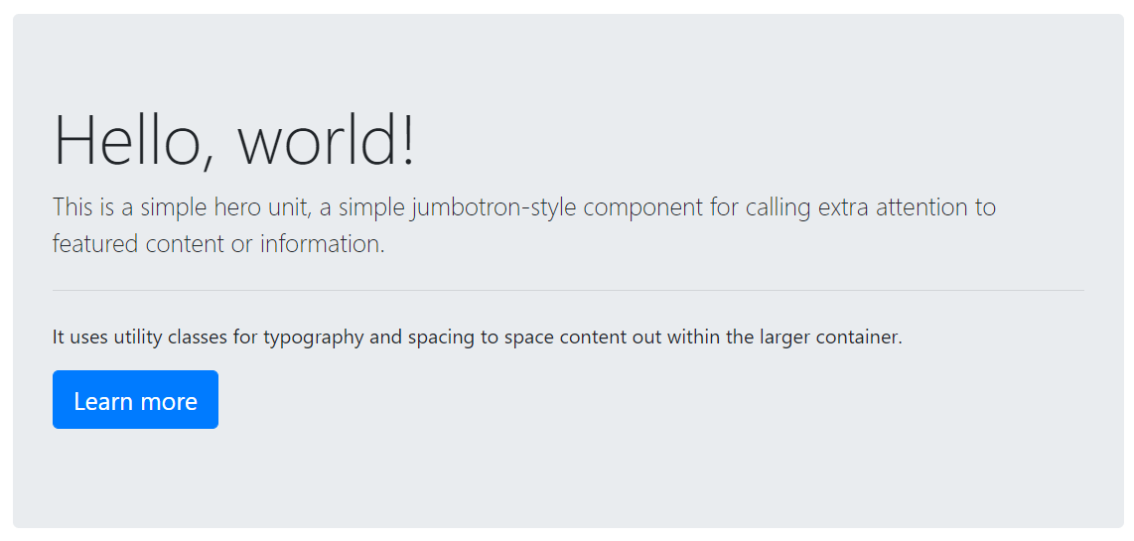
Jumbotron
Lightweight, flexible component for showcasing hero unit style content
<div class="jumbotron">
<h1 class="display-4">Hello, world!</h1>
<p class="lead">This is a ...</p>
<hr class="my-4"><p>It uses ...</p>
<p class="lead">
<a class="btn btn-primary btn-lg">
Learn more</a>
</p>
</div>
See more at: https://getbootstrap.com/docs/4.0/components/jumbotron/

Slide 40

Summary
JS is a dynamic programming language
Functions in JS
JS objects hold key-value pairs
Bootstrap is the most popular front-end component library
Notes:
40

Slide 41
Questions?
Notes:
41

Slide 42










SoftUni Diamond Partners

Slide 43



Educational Partners

Slide 44
Trainings @ Software University (SoftUni)
Software University – High-Quality Education, Profession and Job for Software Developers
softuni.bg, about.softuni.bg
Software University Foundation
softuni.foundation
Software University @ Facebook
facebook.com/SoftwareUniversity
Software University Forums
forum.softuni.bg
Notes:
44

Slide 45

License
This course (slides, examples, demos, exercises, homework, documents, videos and other assets) is copyrighted content
Unauthorized copy, reproduction or use is illegal
© SoftUni – https://about.softuni.bg/
© Software University – https://softuni.bg
Notes:
45

